Slide 1
Lecture 9.
Observer Pattern (观察者模式)
(Behavioral)
行为模式关心算法和对象之间的责任分配。
它关心的不是仅仅描述对象或类的模式，而是要更加侧重描述它们之间的通信模式。
行为模式刻画了很难在运行时跟踪的复杂的控制流。该模式将软件开发者的注意力从控制流转移到对象相互关联的方式方面。
Professor:
Yushan (Michael) Sun
Fall 2020

Slide 2
Contents
Leading example to the observer pattern
The observer pattern
Java support for the observer pattern
Design examples in observer pattern

Slide 3
Leading Examples to the Observer Pattern

Slide 4
【例1】演员信息库问题
某知名演员
信息库
宣传人员随时可以查看信息库。缺点：
报道了不该报道的事情，例如个人隐私;
一些别有用心的人会有给演员抹黑的报道。

Slide 5
某知名演员
信息库
改进：
1）宣传人员要注册；不允许查看敏感信息库。
2）由信息库推送应该报道的事情给已注册的宣传员们。

Slide 6
【例2】海洋信息中心问题
OceanSystem
DataAnalyzer
+getData1(): DataStruct1
+getData2(): DataStruct2
+getData3(): DataStruct3
+getData4(): DataStruct4
+getData5(): DataStruct5
+getData6(): DataStruct6
+getData7(): DataStruct7
+getData8(): DataStruct8
+getData9(): DataStruct9
+analyzeData()
+traverseData()
OceanSystem o = new OceanSystem()
While true {
  o. getData1();
  o. getData2();
  …
  o. getData7();
  o. getData8();
  o. getData9();
}
信息中心-被依赖者
依赖者
缺点：不间断的循环调用，浪费了CPU运行能力，效率很低。

Slide 7
改善设计：改善调用方式。
当数据有变化后，OceanSystem对象通知 DataAnalyzer对象，
然后DataAnalyzer再调用相应的OceanSystem对象，获取相关的数据
OceanSystem
DataAnalyzer
+getData1(): DataStruct1
+getData2(): DataStruct2
+getData3(): DataStruct3
+getData4(): DataStruct4
+getData5(): DataStruct5
+getData6(): DataStruct6
+getData7(): DataStruct7
+getData8(): DataStruct8
+getData9(): DataStruct9
+notify()
+analizeData()
+traverseData()
+update()
notify

Slide 8
Observerble/Observer example
1. Leading Example to the Observer Pattern
【例3】大气监测显示的例子。
假设一个大气监测台，用于监测北京城市大气质量，然后画出大气中所包含的
  可吸入颗粒浓度；
  一氧化碳浓度；
  二氧化碳浓度
随时间的变化曲线。

Slide 9
1. Leading Example to the Observer Pattern
Initial design:
AirMonitor
-data: DataStruct
ClientGUI
+getData(): DataStruct
+drawPM25Curve(): void
+dispPM25Curve(): void
+drawCOCurve(): void
+dispCOCurve (): void
+drawCO2Curve(): void
+dispCO2Curve(): void
Disadvantage: this design is difficult to extend.
For improved design, see next page

Slide 10
将AirDsp子类对象注册到Air对象
Air对象及时通知AirDsp子类对象
Client
Air
-a: ArrayList<AirDsp>
+register(d: AirDsp)
+inputAirData(): void
+notify(): void
+getData(): DataStruct
for(k=0; k< a.size(); k++){
ad = a.elementAt(k);
ad.drawCurve(this)
ad.display(this) }
AirDsp
3. AirDsp子类
对象绘图并且显示
相应的数据
notify
+drawCurve: void
+display(): void
air.getData()
air.getData()
air.getData()
PM25Dsp
CODsp
CO2Dsp
+drawCurve(air: Air)
+display(): void
+drawCurve(air: Air)
+display(): void
+drawCurve(air: Air)
+display(): void

Slide 11
1. Leading Example to the Observer Pattern
改善设计的优点：松散的耦合
容易修改代码
  当需要修改Air代码的时候，AirDsp层次类不受影响
  当需要修改AirDsp代码的时候， Air类不受影响
容易扩展：
  容易在AirDsp中增加新子类，而 原来已经存在的所有的类都不受影响
Back

Slide 12
Observer Pattern

Slide 13
2. Observer Pattern
DESCRIPTION
观察者模式对于设计一个在Observer和Subject之间 一致的通讯模型很有用
The Observer pattern is useful for designing a consistent communication model between
  Observers: a set of dependent objects and
  Subject: an object that they are dependent on.
当你可以将一个程序中的对象分为主题与观察者的时候，可以使用如下的观察者模式进行设计。

Slide 14
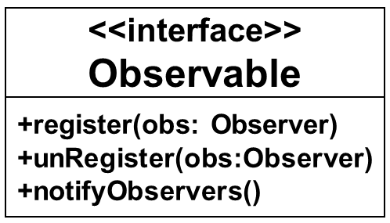
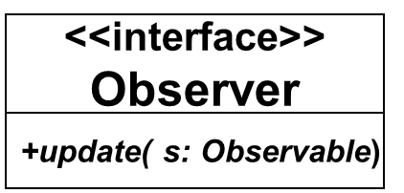
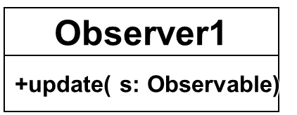
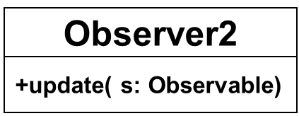
2. Observer Pattern
<<notifies>>
1..* 1..*
Subject
-list: ArrayList<Observer>
+getState()
+notifyObservers()
+register(obs: Observer)
+unRegister(obs:Observer)
1..* 1..*
<<调用主题对象的某些方法>>
1..* 1..*
Class Diagram for Observer pattern

Slide 15
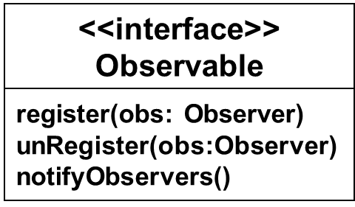
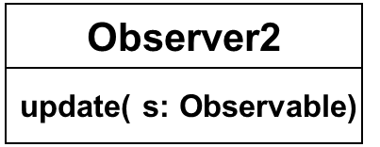
2. Observer Pattern
Observable S = new Subject();
Observer O = new Observer1();
S.register(O);
Client
<<interface>>
Observer
update( s: Observable)
Observer1
S(主题对象)
Subject
update( s: Observable)
O (观察者对象)
利用S调用
getState()
notifyObservers()
register(obs: Observer)
unRegister(obs:Observer)
调用update将S传入到Observer1中
观察者模式的典型交互

Slide 16
2. Observer Pattern
Note 1:
一个主题可以有多个观察者。A subject can have more than one such observer. Each of these observers needs to know when the subject undergoes a change in its state.
主题保持一个动态列表，记录已经注册的观察者The subject must maintain a dynamic list for registering observers.
  (The subject cannot maintain a static list of such observers as the list of observers for a given subject could change dynamically).

Slide 17
2. Observer Pattern
How the observer pattern works?
Observer must register itself：
  Any object with interest in the state of the subject needs to explicitly register itself as an observer with the subject.
Observable must notify the observers：
  Whenever the subject undergoes a change in its state, it notifies all of its registered observers.
An observer can query about the state of the obsevable：
  Upon receiving notification from the subject, each of the observers queries the subject to synchronize its state with that of the subject’s.

Slide 18
2. Observer Pattern
通知观察者的两种策略:
推模式. The push model(将观察者所需数据全部推给观察者, 例如，
  update(Object a)): The subject should send the state information that the observers may be interested in
拉模式. The pull model(主题提供接口，供观察者访问，例如
  update(Observable obs)): The subject should provide an interface that enables observers to query the subject for the required state information to update their state.
【注】观察者模式有许多变形

Slide 19
2. Observer Pattern
Advantages of the Observer pattern:
可以动态添加观察者而不需要影响主题。
Different observers can be added dynamically without requiring any changes to the Subject class.
2. 当主题的状态或者逻辑发生变化的时候，观察者不受影响。
When the state or logic of the subject changes, observers remain unaffected

Slide 20
2. Observer Pattern
何时使用观察者模式？
The observer pattern is used when:
  一个对象的状态改变必须反映在另一个对象中，而你又不想让两个对象保持高耦合 the change of a state in one object must be reflected in another object without keeping the objects tight coupled.
  你设计的框架将来需要添加许多观察者，而你希望以最小限度地改变程序 the framework we are writing needs to be enhanced in future with new observers with minimal changes.
Back

Slide 21
Java support for the Observer Pattern

Slide 22
3. Java support for the Observer Pattern
Java语言环境对观察者模式的支持。
Java API提供了以下的
Observable
<<interface>>
Observer
+addObserver(observer:Observer)
+setChanged()
+notifyObservers(event: Object)
+update(o: Observable, e: Object)
既拉又推的方式
被观察者类
观察者接口

Slide 23
3. Java support for the Observer Pattern
Observable类：在该类中，所有的三个方法
  addObserver(observer:Observer)
  setChanged()
  notifyObservers(event: Object)
都已经实现了。
Observer 接口: 在Observer 接口中，
update(o: Observable, e: Object)
方法带有两个参数。

Slide 24
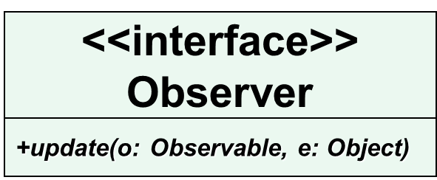
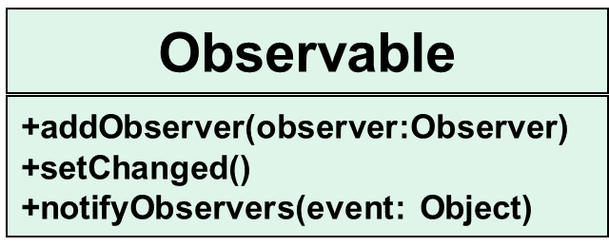
3. Java support for the Observer Pattern
<<notifies>>
1..* 1..*
某些事件
ConcreteObserver1
ConcreteObserver2
+update(o: Observable,
e: Object)
+update(o: Observable,
e: Object)
Subject
1..* 1..*
getState()
<<retrieves state info>>
1..* 1..*
Java支持的观察者模式类图-既拉又推

Slide 25
Observable S = new Subject();
Observer O = new Observer1();
S.addObserver(O);
Client
Observable
<<interface>>
Observer
+addObserver(observer:Observer)
+setChanged()
+notifyObservers(event: Object)
+update(o: Observable, e: Object)
Observer1
Subject
S(主题对象), event（事件对象）
O (观察者对象)
+update(o: Observable, e: Object)
+method1()
+method2()
+method3()
+getState()
S
event
利用S调用
Java支持的观察者模式-典型交互

Slide 26
3. Java support for the Observer Pattern
Observable/Observer策略工作机制
被观察者可以将一个观察者添加到一个list. 这也说明被观察者同意被该观察者观察。
setChanged()和notifyObservers()将通知观察者主题对象的状态已经改变了，观察者对象的update()方法将自动运行。
在观察者对象的update()方法中，如果需要，可以调用被观察者中的相应方法，确切了解状态变化的细节。
Back

Slide 27
Design Examples Using the Observer Pattern

Slide 28
Observerble/Observer example
4. Design Examples Using the Observer Pattern
Example: 温度转换程序设计的例子。 We try to display temperature measures in Celsius, Fahrenheit and Kelvin.
We use a TemperatureGUI for users to enter degrees of temperature in
  Celsius or
  Fahrenheit or
  Kelvin.
Then the other 3 graphical guis will display the temperature both in Celsius and Fahrenheit.

Slide 29
4. Design Examples Using the Observer Pattern
In such case, we can use observer design pattern
  Encapsulate the TemperatureGUI as a class that implements interface Observable, and
  Encapsulate the CelsiusGUI, FahrenheitGUI and KelvinGUI as 3 classes that implement interface Observer

Slide 30
4. Design Examples Using the Observer Pattern
Design 1
使用用户定义的观察者模式
User defined Observerble/Observer pattern

Slide 31
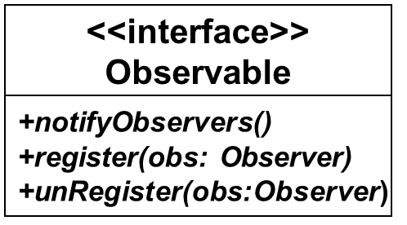
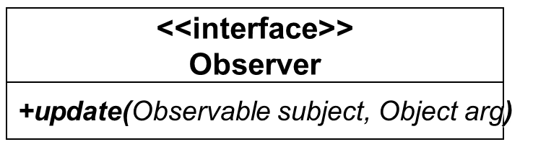
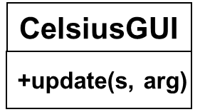
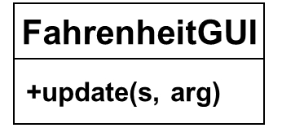
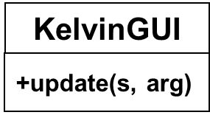
4. Design Examples Using the Observer Pattern
notifies
1 1..*
TemperatureGUI
-list: ArrayList<Observer>
+notifyObservers()
+register(obs: Observer)
+unRegister(obs:Observer)
1 1..*
1 1..*
1 1..*
观察者或者客户程序必须调用Observable的注册方法，将自己注册到Observable对象里面
TemperatureGUI对象的状态发生改变的时候，必须通过notifyObservers()通知过程者对象 CelsiusGUI, FahrenheitGUI, and KelvinGUI

Slide 32
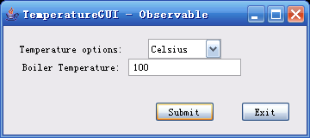
4. Design Examples Using the Observer Pattern
被观察者

Slide 33
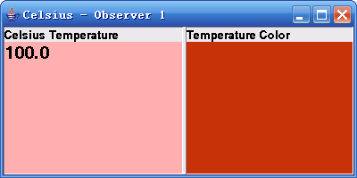
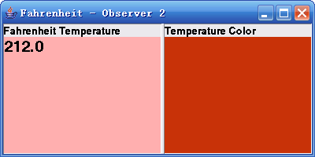
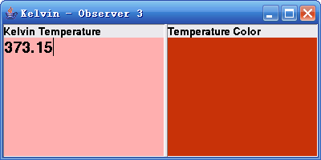
观察者1
观察者2
观察者3

Slide 34
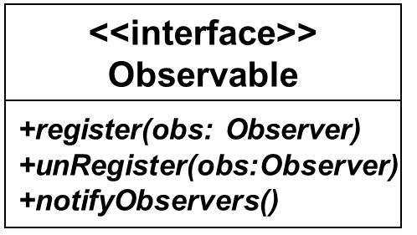
Observable t = new TemperatureGUI()
Observer c = new CelsiusGUI();
Observer f = new FahrenheitGUI;
t.register(c);
t.register(f);
Client
<<interface>>
Observer
+update(Observable subject, Object arg)
CelsiusGUI
FahrenheitGUI
t(主题), arg(事件)
t(主题), arg(事件)
TemperatureGUI
+update( t，arg)
+update( t, arg)
c (观察者对象)
f (观察者对象)
传入t, arg
利用t调用
利用t调用
+getState()
+notifyObservers()
+register(obs: Observer)
+unRegister(obs:Observer)
传入t, arg
利用观察者模式设计的温度转换程序的典型交互

Slide 35
4. Design Examples Using the Observer Pattern
Design highlights: Two interfaces
  Observable
  Observer
with exactly all of their methods claimed in the design.
In TemperatureGUI, you need to implement all the methods:
  notifyObservers()
  register(obs: Observer)
  unRegister(obs:Observer)

Slide 36
4. Design Examples Using the Observer Pattern
In the CelsiusGUI, FahrenheitGUI, and KelvinGUI, you need to implement the method
  update(Observable subject, Object arg)

Slide 37
public class TemperatureGUI implements Observable{
ArrayList(<Observer>) observersList = new ArrayList(<Observer>);
public void register (Observer obs) { observersList.add(obs);}
public void unRegister(Observer obs){ observersList.remove(obs); }
public void notifyObservers(String temperature) {
for (int i = 0; i < observersList.size(); i++) {
Observer observer = (Observer)observersList.elementAt(i);
observer.update (this, temperature); //call update method in all the
//observers
}
}
class ButtonHandler implements ActionListener{
public void actionPerformed(ActionEvent e){
if (e.getActionCommand().equals(SUBMIT)){
String tem = boilerTem.getText(); //get temperature
setTemperature(tem); //set temperature to the private variable
notifyObservers(bTem); //notify the observers that the temperature has
//changed
} } } }}

Slide 38
public class CelsiusGUI extends JFrame implements Observer{
tempGui.register(this);
public void update( Observable subject, Object arg) {
String t = (String) arg; // 从参数传入的温度值
// parameter subject represents observable，object of TemperatureGUI is
// passed in from here. See how to call the update method in method
//notifyObservers in class TemperatureGUI
TemperatureGUI tg = (TemperatureGUI)subject; //从参数传入的
//被观察者对象
String option = tg.getSelectedTemExpression(); //使用此对象调用
//被观察者
TemperatureConvertor tc = new TemperatureConvertor();
float cTem = tc.getCelsiusTemperature(option, t);
tempTextArea.setText(“”+cTem); //将摄氏温度显示在屏幕上
} }

Slide 39
4. Design Examples Using the Observer Pattern
public class TestObserverObservable {
public static void main(String[] args) throws Exception {
//create an observable object
TemperatureGUI temperatureObj = new TemperatureGUI();
//Create Observer objects
CelsiusGUI cg = new CelsiusGUI();
FahrenheitGUI fg = new FahrenheitGUI();
KelvinGUI kg = new KelvinGUI();
}
}
注意：这里没有addObserver方法的调用，是因为在
CelsiusGUI中，已经有tempGui.register(this);

Slide 40
4. Design Examples Using the Observer Pattern
通常，在客户程序中，可以做以下事情:
  1）create object of observable
TemperatureGUI tempObj = new TemperatureGUI();
  2）create object of observer
CelsiusGUI cg = new CelsiusGUI();
FahrenheitGUI fg = new FahrenheitGUI();
KelvinGUI kg = new KelvinGUI();
  3）register observers to the observable
  tempObj.register(cg);
  tempObj.register(cg);
  tempObj.register(cg);
  4) temperatureObj.notifyObservers(bTem);

Slide 41
4. Design Examples Using the Observer Pattern
Design 2
使用Java API 的Observer接口和Observable类。

Slide 42
4. Design Examples Using the Observer Pattern
Design 2: 使用Java API提供的观察者机制
Use the java built in event handling strategy.
In this design, java
  Observable class and
  Observer interface
are used, the design is as below.

Slide 43
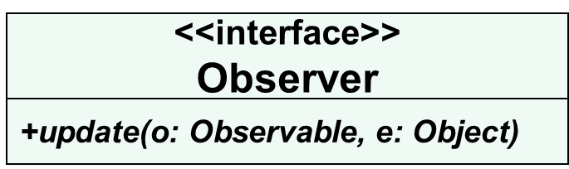
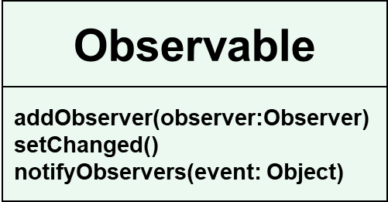
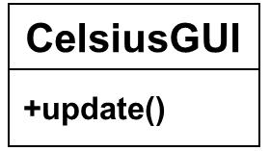
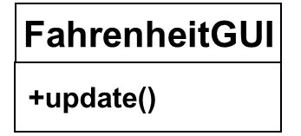
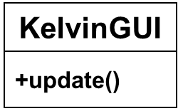
4. Design Examples Using the Observer Pattern
TestObserverObservable
notifies
1 1..*
TemperatureGUI
-bTem: String
+getSelectedTemExpression()
+setTemperature(String tem)
1 1..*
1 1..*
1 1..*
Observerble/Observer

Slide 44
4. Design Examples Using the Observer Pattern
Observable t = new TemperatureGUI();
Observer c = new CelsiusGUI();
t.addObserver(c);
Client
Observable
<<interface>>
Observer
+addObserver(observer:Observer)
+setChanged()
+notifyObservers(event: Object)
+update(o: Observable, e: Object)
CelsiusGUI
TemperatureGUI
t(主题对象), event（事件对象）
c (观察者对象)
+update(o: Observable, e: Object)
+getSelectedTemExpression()
+setTemperature(String tem)
t
温度
利用t调用
利用Java提供的类与接口与观察者模式计的温度转换程序的典型交互

Slide 45
4. Design Examples Using the Observer Pattern
客户类. In the TestObserverObservable, use addObserver(observer:Observer) to add an observer CelsiusGUI, FahrenheitGUI, and KelvinGUI to the TemperatureGUI object
被观察类. In class TemperatureGUI, use setChanged() and notifyObservers() together to notify the observer that the state of the Object TemperatureGUI has changed, and
  then the update(o: Observable, e: Object) method in CelsiusGUI, FahrenheitGUI, and KelvinGUI objects will be automatically invoked to update display of temperature.
  In the update method, in turn, observable can be called to check the state change.

Slide 46
4. Design Examples Using the Observer Pattern
被观察者图形界面

Slide 48
4. Design Examples Using the Observer Pattern
public class TemperatureGUI extends Observable{
class ButtonHandler implements ActionListener{
public void actionPerformed(ActionEvent e){
if (e.getActionCommand().equals(SUBMIT)){
String tem = boilerTem.getText(); //获得用户输入温度值
setTemperature(tem);
setChanged();
notifyObservers(bTem);
//notifyObservers的实现中，调用了观察者类的
//update(Observable subject, Object arg) 方法
//温度bTem经由参数arg传入观察者
}
}
} }}

Slide 49
4. Design Examples Using the Observer Pattern
public class CelsiusGUI extends JFrame implements Observer{
private JTextArea tempTextArea;
private Container contentPane;
//此处省略了图形界面生成代码
public void update(Observable subject, Object arg) {
String t = (String) arg; //用户输入的温度数值
//参数subject代表被观察者TemperatureGUI对象
TemperatureGUI tg = (TemperatureGUI)subject;
String option = tg.getSelectedTemExpression();
TemperatureConvertor tc=new TemperatureConvertor();
float cTem = tc.getCelsiusTemperature(option,t);
tempTextArea.setText("Celsius Temp: \n"+ cTem);
}
}

Slide 50
4. Design Examples Using the Observer Pattern
public class TestObserverObservable {
public static void main(String[] args) throws Exception {
//create an observable object
TemperatureGUI temperatureObj = new TemperatureGUI();
//Create Observer objects
CelsiusGUI cg = new CelsiusGUI();
FahrenheitGUI fg = new FahrenheitGUI();
KelvinGUI kg = new KelvinGUI();
//Add observers
temperatureObj.addObserver(cg);
temperatureObj.addObserver(fg);
temperatureObj.addObserver(kg);
}
}

Slide 51
4. Design Examples Using the Observer Pattern
在客户类的主方法中，应该包括的内容：
  1）create objects of observable
TemperatureGUI temperatureObj = new TemperatureGUI();
  2）create objects of observers
CelsiusGUI cg = new CelsiusGUI();
FahrenheitGUI fg = new FahrenheitGUI();
KelvinGUI kg = new KelvinGUI();
  3）register observer objects to observable object
  temperatureObj.addObserver(cg);
  temperatureObj.addObserver(fg);
  temperatureObj.addObserver(kg);
  4）notify observer
setChanged();
notifyObservers(bTem);
Back

